Slide 1
What is the difference between BIAS versus VARIANCE?
The goal of any supervised machine learning algorithm is to achieve low bias and low variance.
Bias-Variance trade-off is an important factor in the success of your predictive model

Slide 2
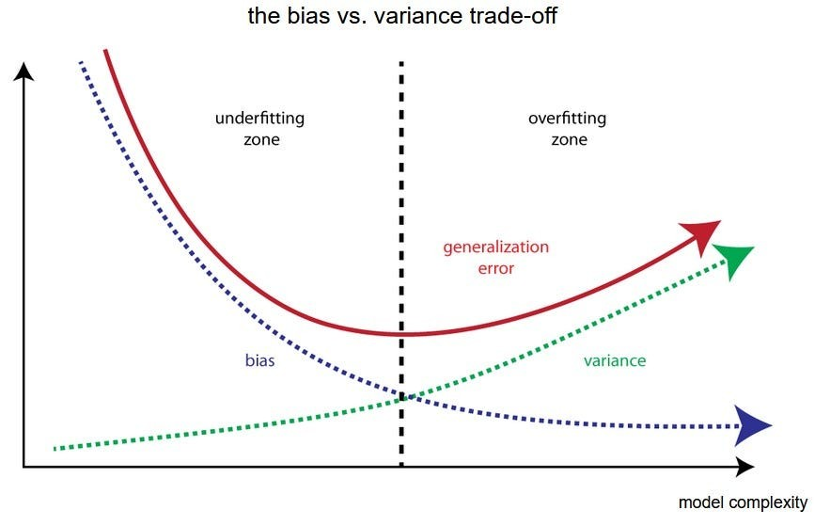
Bias-Variance Trade-off

Slide 3
Bias Error:
Bias are the simplifying assumptions made by a model to make the target function easier to learn
This can lead to overfitting if the model becomes too complex and starts fitting the noise in the training data rather than the true underlying patterns
Regularization techniques and cross-validation are often used to address overfitting by controlling the model's complexity
Low Bias (recommended):
Suggests less assumptions about the form of the target function
Examples of low-bias machine learning algorithms include:
Decision Trees,
k-Nearest Neighbors and
Support Vector Machines

Slide 4
Variance Error:
Variance is the amount that the estimate of the target function will change if different training data was used.
Low variance implies that the model is more stable and less sensitive to the training data, producing similar results across different datasets.
Low Variance (recommended):
Might result in underfitting if the model is too simplistic and cannot capture the underlying patterns in the data
Examples of low-variance machine learning algorithms include:
Linear Regression,
Linear Discriminant Analysis and
Logistic Regression

